Slide 1
#01 Class, Abstract Class and Interfaces
Notes:
Give an explanation for the concepts class, abstract class and interface
Relevant theoretical decisions
What are classes and objects and what is special for these concepts?
What are visibility modifiers and how are they used in a program?
What is an interface and what is it used for?
What is an abstract class, when and how is it used?
What is garbage collection and what is the purpose for that?

Slide 2
Class

Slide 3
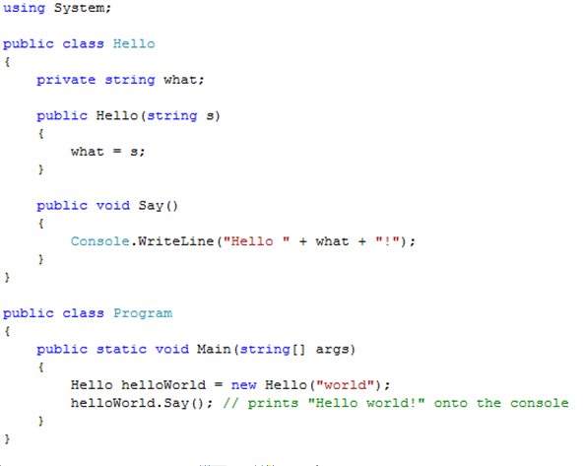
Class Example and Visibility

Slide 4

Interfaces
“An interface is a contract that guarantees to a client how a class will behave”
A Class can implement more the one interface
Interfaces can be extended and combined

Slide 5
Abstract Class

Slide 6
Abstract Class Vs Interface

Slide 7
Garbage Collector
C# performs automatic garbage collection
Collection/removing objects that are marked as garbage
Object that no longer has a reference
C# programmers don’t need to worry about explicitly reclaiming memory that has become garbage

Slide 8
Use in our program

Slide 9
Use in our program

